Slide 1


Analysis of Seattle 911 Police Incident Response Time Using Machine Learning
By Cheryl Kung

Slide 2
Introduction
Objective: Using the Seattle 911 Incident Response dataset provided by city of Seattle, used unsupervised machine learning to see if there are correlations between the police response time and the community they serve

Slide 3
Dataset
Dataset contains 18 different features, however many overlap
Main four features
Location
Time to arrive at event
Time to clear event
Type of event
Notes:
For example, location data was represented by the census tract, the longitude and latitude, as well as the district.

Slide 4
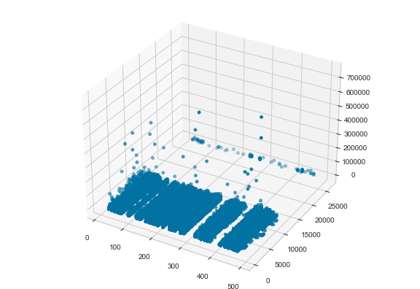
Initial Dataset
Removed rows with missing values
Removed outliers that were outside three standard deviations
Transformed arrival time and clearance time to one feature
Separated year of event to different variable
Final dataset had 224585 entries
Time
At
Scene
Event
Census Tract

Slide 5
US Census Supplementation
US Census American Community Survey
Percentage of White Residents
Median Household Income
Other potential features:
Education level
Sex
Household members
Create Lookup Table for specific features
Use lookup Table to map values to incidents

Slide 6
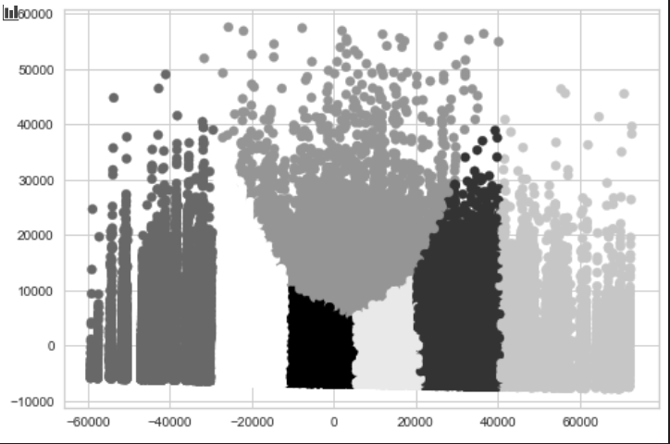
Principal Component Analysis
Used PCA to reduce six features to two for easy graphical representation

Slide 7

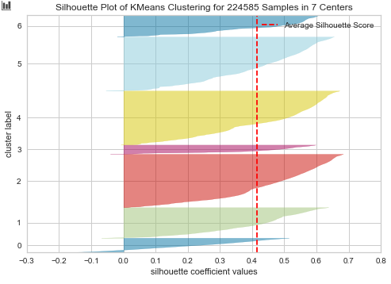
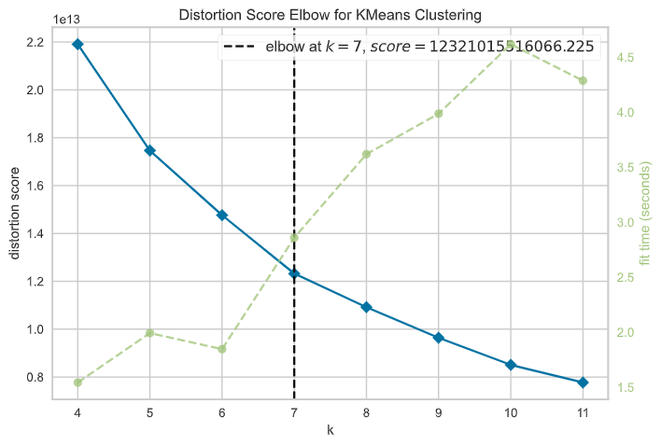
Clustering
Attempted to use Agglomerative Spectral Clustering, but limited by hardware in computer
Used K-means due to simplicity
Used the Yellowbrick Python library to determine optimal number of clusters

Slide 8
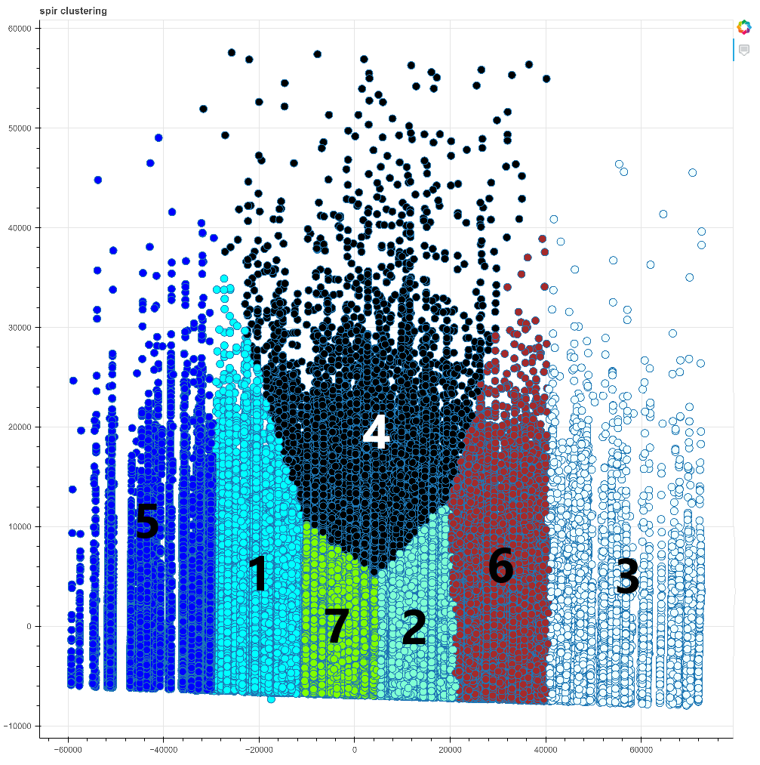
Labeled Clusters

Slide 9
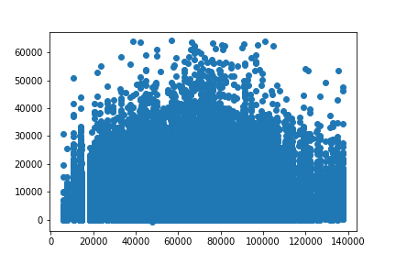

Analysis
Time
income
Notes:
Most variation across time and income?

Slide 10
Income
 | Income (Mean) $ | Income (Median) $
All | 65304.80 | 65960
5 | 26044.41 | 26886
1 | 45067.64 | 45511
7 | 62773.74 | 62980
4 | 68683.1 | 69130
2 | 77424.03 | 76320
6 | 94868.49 | 93155
3 | 116435.7 | 113432

Slide 11
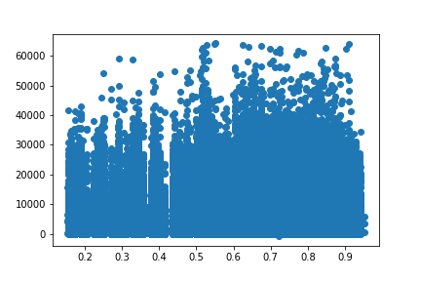
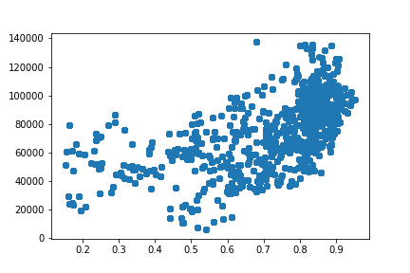
Income vs Percentage of White Residents
Income vs percentage of white residents in the area are correlated, but not the time at the scene
Time (s)
Income ($)
Percentage of White Residents
Percentage of White Residents

Slide 12
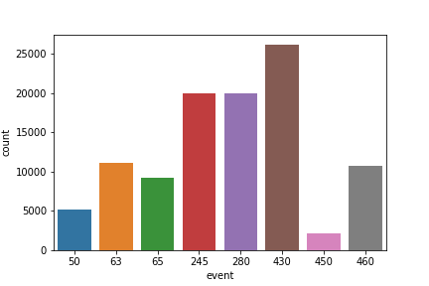
Types of Events: All
Event Clearance Code | Event
430 | Accident Investigation
245 | Disturbance – Other
280 | Suspicious Person
63 | Theft – car prowl
460 | Traffic (Moving) Violation
65 | Theft – Miscellaneous
50 | Burglary – residual, unoccupied
450 | DUIs

Slide 13
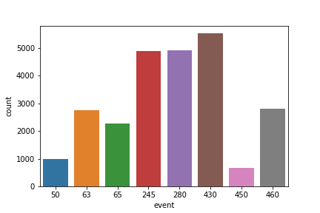
Types of Events: Cluster 5
Event Clearance Code | Event
430 | Accident Investigation
245 | Disturbance – Other
280 | Suspicious Person
63 | Theft – car prowl
460 | Traffic (Moving) Violation
50 | Burglary – residual, unoccupied
65 | Theft – Miscellaneous
450 | DUIs

Slide 14
Types of Events: Cluster 4
Event Clearance Code | Event
430 | Accident Investigation
245 | Disturbance – Other
280 | Suspicious Person
63 | Theft – car prowl
460 | Traffic (Moving) Violation
65 | Theft – Miscellaneous
50 | Burglary – residual, unoccupied
450 | DUIs

Slide 15
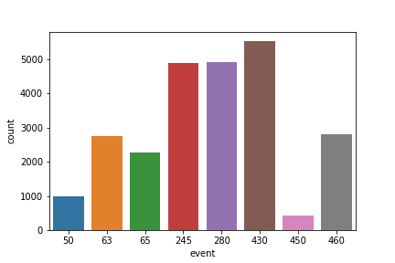
Types of Events: Cluster 3
Event Clearance Code | Event
430 | Accident Investigation
245 | Disturbance – Other
280 | Suspicious Person
63 | Theft – car prowl
460 | Traffic (Moving) Violation
65 | Theft – Miscellaneous
50 | Burglary – residual, unoccupied
450 | DUIs

Slide 16
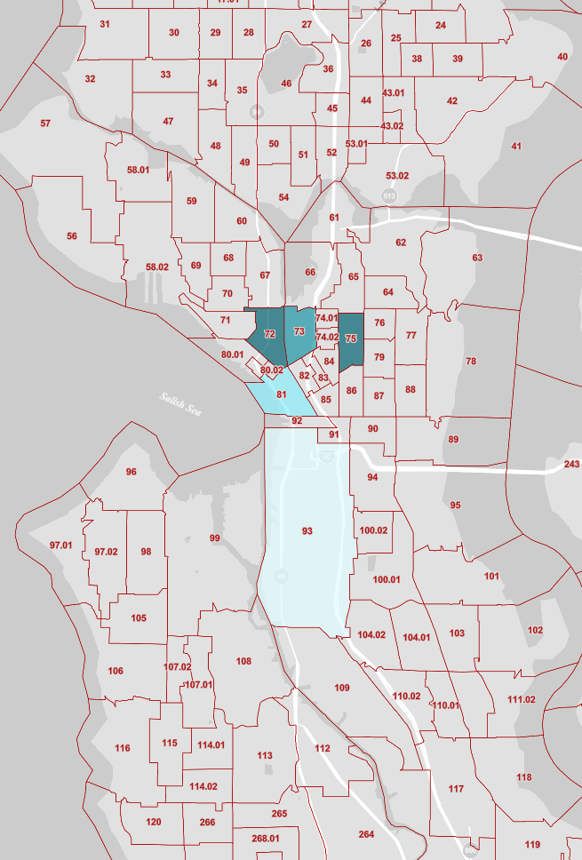
Top Locations: All
Clustered around downtown Seattle
81 – Pike Place
93
75
72
73

Slide 17
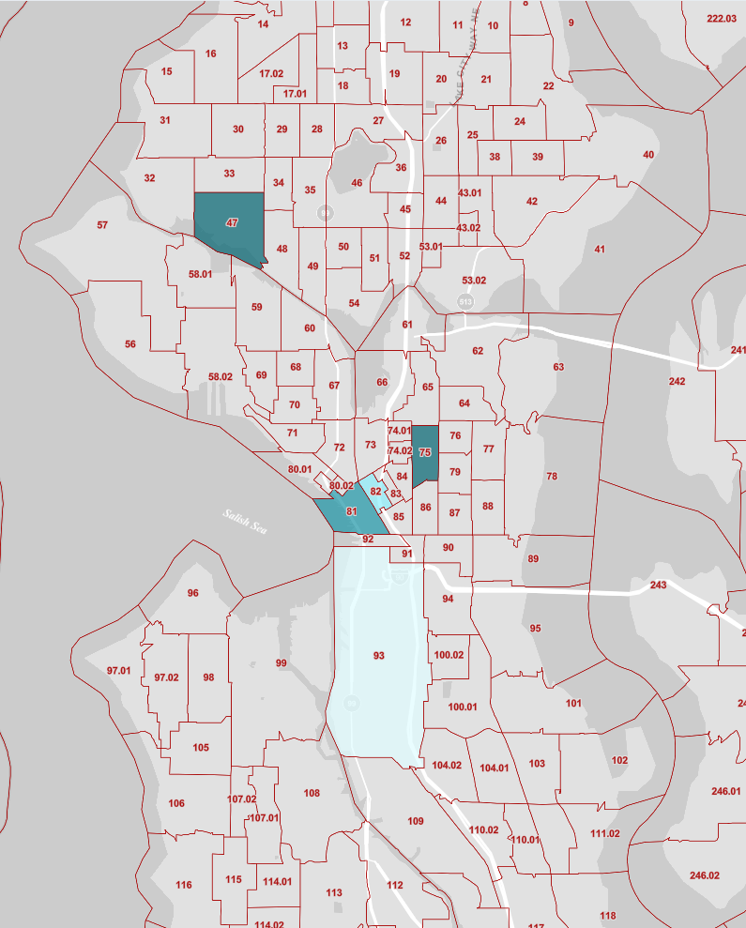
Top Location: Cluster 4
Closer to downtown area
81
93
75
47
82

Slide 18
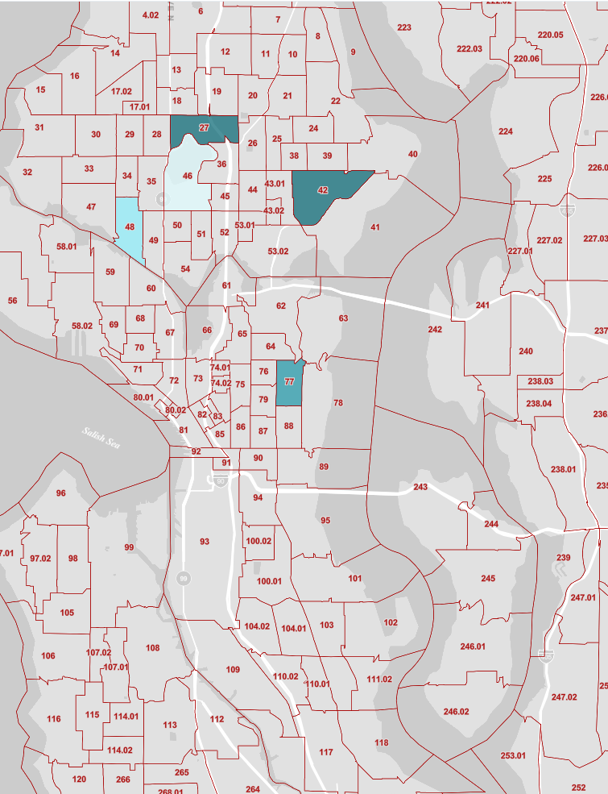
Top Locations: Cluster 3
Northwest Seattle, Green Lake area
27
42
48
46
77

Slide 19
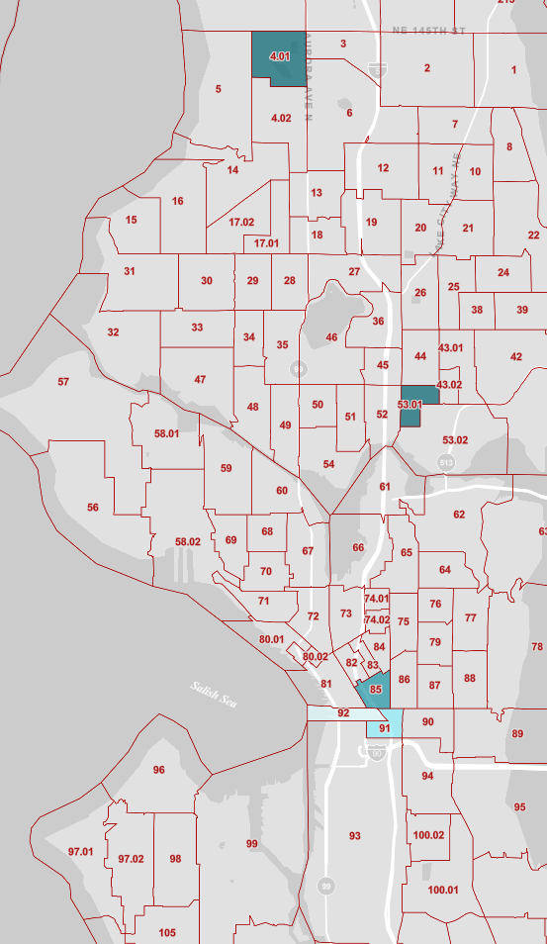
Top Locations: Cluster 5
Neighboring wealthier areas
92
53.01
91
85
401

Slide 20
Conclusions
Police spend the most time in areas with median income levels closest to the overall Seattle median income
Future improvements
Add more features
Use more recent data from data.seattle.gov
Look into outliers
Use different clustering algorithms

